Slide 1
Z3
SMT Solver

Slide 2
SMT Solver
In computer science and mathematical logic, the satisfiability modulo theories (SMT) problem is a decision problem for logical formulas with respect to combinations of background theories expressed in classical first-order logic with equality. Examples of theories typically used in computer science are the theory of real numbers, the theory of integers, and the theories of various data structures such as lists, arrays, bit vectors and so on. SMT can be thought of as a form of the constraint satisfaction problem and thus a certain formalized approach to constraint programming.
一 WIKI

Slide 3
Q: X + 5 = 10, X = ?
Q: X + Y = 10
6X + Y = 20
X = ?, Y = ?

Slide 4
Q: X + 5 = 10, X = ?
Q: X + Y = 10
6X + Y = 20
X = ?, Y = ?
寫程式來解？

Slide 5
Q: X + 5 = 10, X = ?
Q: X + Y = 10
6X + Y = 20
X = ?, Y = ?
pip install z3-solver

Slide 6
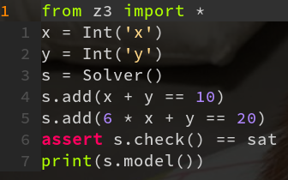
pip install z3-solver
http://bit.ly/34ipe1D

Slide 7
《張立建算經》
題：用100元購買了100隻雞，公雞一隻5塊錢，母雞一隻3塊錢，小雞三隻一塊錢。
問：公雞、母雞、小雞各有多少只？

Slide 8

Give me the flag

Slide 9

Math teacher

